Slide 1
My Forgiveness
My Responsibility

Slide 2
My Forgiveness
What do I understand by ‘Forgiveness?’
Am I able to forgive?
Am I worthy of forgiveness?
How can my forgiveness help to improve my sense of wellbeing?
How can my forgiveness help improve my relationship with my Creator and others?
What can help me become more forgiving and worthy of forgiveness?
How does my envy, lust, greed, sloth, ego and anger affect my ability to forgive and be forgiven?

Slide 3
My Forgiveness
What do I understand by ‘forgiveness?’
What is ‘forgiveness’ without sin or the concept of doing or saying something ‘wrong’ that causes harm?
What do I understand by ‘sin?’
What do I understand by ‘good’ and ‘evil’? How does my understanding of what is good and evil or right from wrong affect my ability to forgive and seek forgiveness?
What affects my ability to have judgement of good vs bad and right vs wrong? Is it an innate part of Me or have I learnt it?
Do I treat others how I want to be treated?

Slide 4
My ability to Forgive
Do I find it easy to forgive others who cause harm to me or my loved ones? If not- why not?
Can I think of any examples when I found it difficult to forgive?
How does my inability to forgive others affect my sense of spiritual, physical, emotional mental wellbeing?
How does my inability to forgive affect my relationship with my Creator, and with others?
How does my inability to forgive affect my ability to attain inner Peace?
How does my inability to forgive affect my ability to fulfill my life purpose?

Slide 5
My ability to Forgive
How many times should I forgive someone for the same mistake? Should I forgive and forget?
What makes it more likely that I will be able to forgive someone?
Am I more able to forgive someone that I love ‘unconditionally’? How can my Love help me to be more forgiving?
Am I more able to forgive someone that I can relate to? How can reflecting on my own experiences help me to be more forgiving? How can seeing myself in you help me to be more forgiving? How can my Compassion and empathy help me to forgive more?
Am I more able to forgive someone that I consider to be ‘part of me?’ How can seeing you in me help me to be more forgiving?
Am I more able to forgive someone that I know is ‘sincere’ in their repentance? How can my own sincerity and my ability to see good in others help me to become more forgiving?
Am I more able to forgive someone that I respect? How can my Respect help me to become more forgiving?

Slide 6
My ability to Forgive
Am I more able to forgive someone that is humble? How can my humility affect my ability to be more forgiving?
Am I more able to forgive someone that is actively trying to better themselves? How can my ability to ‘seek truth’ and my desire to ‘improve myself’ affect my ability to forgive?
Am I more able to forgive someone that actively shows me how sorry they are? How can acts of loving kindness help me to become more forgiving?
Am I more able to forgive someone that is faithful to me? How does my ability to be ‘loyal’ affect my ability to forgive?
Am I more able to forgive someone that is grateful? How does my ability to be grateful affect my ability to forgive?
Am I more able to forgive someone that has a forgiving nature themselves? How does my ability to seek forgiveness affect my ability to forgive?

Slide 7
Can I be Forgiven?
Am I a ‘forgiving’ person or am I vengeful? And why? Is it just ‘Me?’ or do I ‘choose’ to be like this?
Do I feel worthy of forgiveness from that which is Higher than myself or from others, when I make mistakes or cause others harm? And why? What prevents me from seeking forgiveness?

Slide 8
Can I be Forgiven?
Am I worthy of forgiveness? How will repentance help me?
Do I carry the burden of guilt on my shoulders for all the harm that I have caused with my speech and behavior in the past?
How can my conscience help to direct me to repentance?
What is it that kills my conscience? When do I stop feeling guilty? Is it not when I ignore that voice inside which tells me that what I am doing is wrong and continue to make the same mistakes over and over while feeling the guilt? How can I wake up my conscience? Who will give it back to me? Is it too late?
What makes me feel more worthy of forgiveness? Am I Sincere? Am I Just? Am I Peaceful? Am I respectful? Am I humble? Am I compassionate? Am I patient? Am I faithful? Am I grateful? Am I Forgiving? Am I able to take responsibility for my own behavior to the best of my ability?
How does my ability to Give, affect my ability to feel ‘worthy’ to Receive?

Slide 9
Can I be Forgiven?
Who is it that can forgive me? Am I able to forgive myself? What makes me worthy of being able to forgive myself? How can I forgive myself if I cannot forgive others?
Is there Anything that is more Forgiving than Me? How can having Faith in something that is Higher than Myself affect my ability to seek True forgiveness? How can Humility help me to seek forgiveness?
Who is The Most Forgiving One? Am I loved unconditionally? Am I able to refuse responsibility and yet still be forgiven? Is this Justice?
Do I want my sins to be ‘forgotten?’ once I am forgiven? Do I want another chance to make my Relationship work? How many times am I permitted to make the same mistake again? How can Penitence help me feel more worthy of forgiveness?
Do I feel more worthy to be forgiven when I sin out of ignorance or while I know that what I am saying or doing is wrong? Why? How can perseverance in seeking Truth and pursing Justice help me feel more able to repent and mend my ways?

Slide 10
Can I be Forgiven?
Do I believe in a Universal God/ Creator/ Source/Reality/Deity/Existence that is Higher than myself? If not- why not? How does my ego prevent me from seeking forgiveness? If so- surely that Being must be more able to accept repentance than me? So- what prevents me from asking? Do I Believe but feel too proud to ask? Do I Believe but doubt His ability to Forgive? Do I Believe but feel that I am not worthy?
Do I need intermediaries to help connect me to my Source of Existence- my Source of Forgiveness? – if so- why? Who created these intermediaries? Are they the Source of their own creation? Are they able to make decisions without the permission of God? Are they more able to forgive than God Himself? Can they help me if God Himself does not give them permission? What prevents me from asking God Directly? How can my Direct connection my Creator and Source of Existence help me to seek forgiveness? How can I connect to Him Directly?
Is He who created me not able to hear my thoughts? Is He not able to know what I am feeling inside? Is He not Aware of my innermost intentions in my heart? How can He be worthy of being my Source of existence if He is not able to Know me better than I know myself?

Slide 11
My Forgiveness and my Physical Health
How does my inability to forgive others affect my energy levels? Does my anger weigh me down? Does my vengeance drain me out?
How does my forgiveness affect my sense of physical perception?
How does my inability to forgive others affect my perception of my pain and suffering? Do I feel more or less pain when I inflict the pain of suffering from my vengeance on others? Do I try to escape my physical suffering by blaming others for my mistakes? Do I Try to escape repentance by refusing to forgive? Can I escape myself?
How does my inability to repent and mend my ways affect my energy levels? Does my arrogance help me sleep? Does my refusal to take responsibility of my life help me control my physical addiction tendencies? Does it cover over my pain or cure me from my pain?

Slide 12
My Forgiveness and my Mental Health
How does my anger and craving for vengeance within me affect my mood? How does it affect my anxiety levels?
How does my anger and inability to forgive others and seek forgiveness affect my thoughts?
How does my inability to forgive and seek forgiveness it affect my ability to let go of the need to control the future? How does it affect my ability to be more mindful of the present moment and achieve a sense of ‘Peace of Mind?’

Slide 13
My Forgiveness and my Spiritual Health
How does my ability to forgive others and seek forgiveness affect my ability to feel connected tp my Source of Existence and to the rest of creation?
Can I truly be mindful and vengeful at the same time?
Can I feel at Peace and angry with someone at the same time?
Am I able to experience true Love and hate at the same time?
How can forgiveness help me to fly and rise above my evil inclinations? How can my forgiveness and repentance help to raise me up to my Source of Existence and release me from my prison?

Slide 14
My Forgiveness and my Emotional Health
How does my ego prevent me from working on my forgiveness? Can I be arrogant and forgiving at the same time? Can I repent with a sincere heart if I am proud? How can humility help me?
How does my greed prevent me from working on my forgiveness? Can I serve/worship money and God at the same time? Does my physical wealth have the ability to offer me forgiveness? How can sharing my blessings with those who have less than I do help me to repent and forgive?
How does my envy prevent me from working on my forgiveness? Can I forgive the one which I am envious towards? Am I able to repent and mend my ways if I am in ‘competition’ with the One who Made me?

Slide 15
My Forgiveness and my Emotional Health
How does my sloth prevent me from working on my forgiveness? Am I too lazy to reflect on my own faults and take responsibility? Am I too lazy to have compassion on others and pardon their faults? Why then do I complain when I face hardship and suffering- does my sloth desert me in my hour of need?
How does my lust prevent me from working on my forgiveness? How can I find time to reflect and show compassion to the faults of others, and find time to seek forgiveness, if my heart mind and body is distracted by the physical pleasures of this worldly life?
How does my anger and vengeance prevent me from working on my forgiveness? Can I be angry towards the one that I forgive? How can I seek forgiveness from my Creator if I am angry towards Him?

Slide 16
My Forgiveness and my Emotional Health
How does my hatred towards others or myself prevent me from working on my forgiveness? Can I hate the one that I truly love?
How do my fears prevent me from working on my forgiveness? Am I brave enough to have a direct connection with the Most Forgiving One? Do I have the courage to light up the darkness of others with my forgiveness?
How do my sorrows prevent me from working on my forgiveness? How worthy do I feel for forgiveness when I am feeling worthless and guilty? How do my sorrows affect my self confidence and courage? How can my sorrows bring me the humility that can help save me from the prison of my sorrows through repentance?

Slide 17
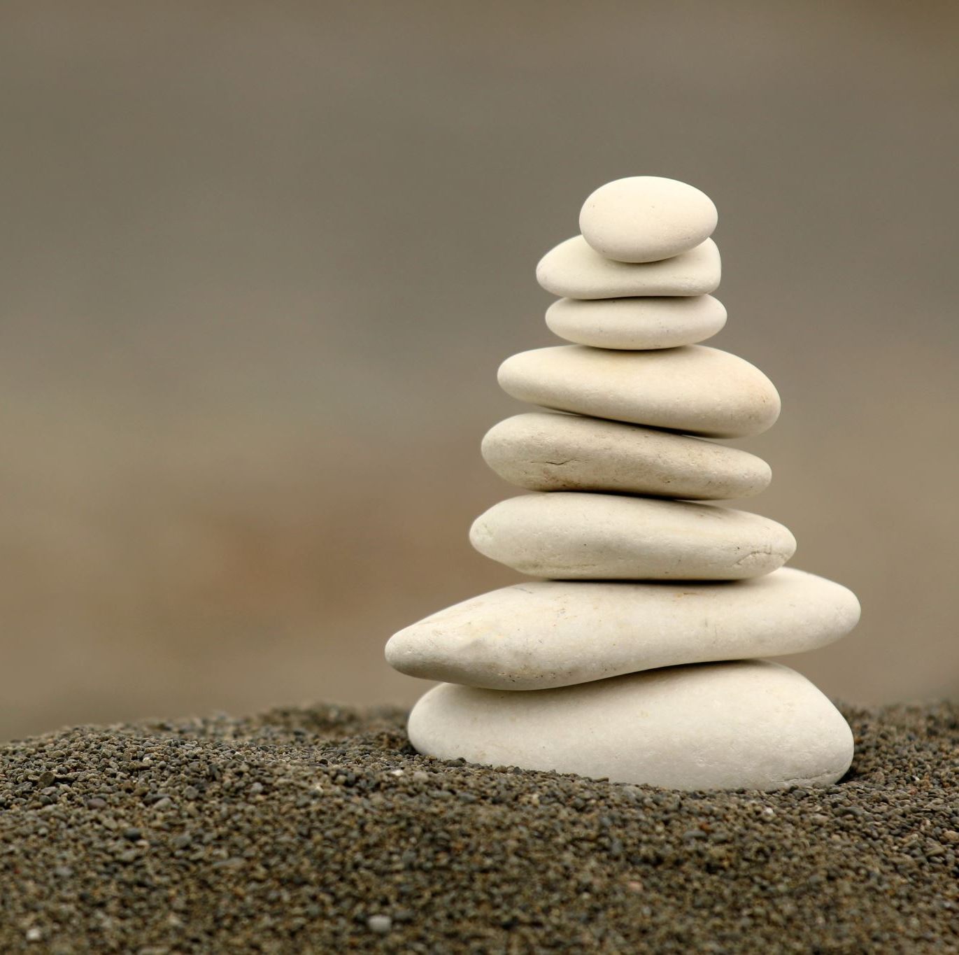
My Forgiveness and my Relationships

Slide 18
How can my ability to forgive others help my Relationships?
With my Creator?
With myself?
With my Partner?
With my Parents?
With my children?
With my siblings and relatives?
With my friends?
With my neighbors?

Slide 19
How can my seeking of forgiveness help my Relationships?
With my Creator?
With myself?
With my Partner?
With my Parents?
With my children?
With my siblings and relatives?
With my friends?
With my neighbors?

Slide 20
What will help me ….
To be more forgiving?
1
To seek forgiveness?
2
So that I can improve my relationships?- for what is the point of my existence without the Relationship?
3

Slide 21
My Forgiveness and my Respect
What is the relationship between my Forgiveness and my Respect?
Can I truly forgive the one that I do not truly respect? Can I respect the one that I cannot forgive?
How can my respect for life and freedom of choice help me to be more forgiving?

Slide 22
My Forgiveness and my Humility
What is the relationship between my Forgiveness and my Humility?
Can I truly forgive the one that I think I am better than?
How can I be arrogant and sincerely sorry at the same time?
How can my humility help me to repent in a way that will enable me to mend my ways and better myself?
How can I have compassion without humility?
How can my humility help me to truly forgive others through empathy and compassion?

Slide 23
My Forgiveness and my Love
What is the relationship between my Forgiveness and my Love?
Can I truly forgive the one that I do not love? Can I truly love the one that I cannot truly forgive?
How can I seek forgiveness without having a relationship? How can I have a relationship without love?
Do I feel truly forgiven if I do not believe that I am truly loved?
How can my love for my Creator and for others help me feel truly forgiven, and be more sincere in my ability to forgive?

Slide 24
My Forgiveness and my Gratitude
What is the relationship between my Forgiveness and my Gratitude?
Do I find it easier or more difficult to forgive the one that I am grateful to and for?
How can my gratitude to/for others help me to be more forgiving?
Can my forgiveness towards others be a way of me expressing my gratitude to my Creator and to others?
How can expressing more gratitude to my Creator help me to feel more worthy of His forgiveness?
How can expressing more gratitude to others help me to feel more able to seek their forgiveness?

Slide 25
My Forgiveness and my Honesty/ Sincerity?
What is the relationship between my Forgiveness and my Honesty/Sincerity?
Can I be insincere and truly forgiving at the same time? Can I truly repent without a sincere heart?
Am I more or less likely to be able to forgive the one that is sincere? How do I know that someone is sincere?
How can I speak and behave in a way that helps me to prove my sincerity in order that I am more able to forgive and seek forgiveness?

Slide 26
My Forgiveness and my Patience
What is the relationship between my Forgiveness and my Patience?
Am I able to be impatient and forgiving at the same time?
Am I more or less likely to be able to forgive the one that I am truly patient with? How can my patience help me to become more forgiving?
Am I more or less likely to be patient with the one that I truly forgive? How can my Forgiveness help me to become more patient?
How can my patience in prayer and acts of loving kindness during times of ease as well as during times of hardship and struggle help me feel more worthy of forgiveness?

Slide 27
My Forgiveness and my Courage
What is the relationship between my Forgiveness and my Courage?
How can my Courage help me to become more forgiving? How can my Forgiveness help me to behave more courage and overcome my fears which hold me back from achieving my life purpose?
Am I able to take responsibility for my mistakes without having the courage to face my darkness? Am I able to seek forgiveness for something that I do not believe is wrong?
How does my fear of being vulnerable of getting hurt again prevent me from offering my forgiveness?
How can my Courage to forgive help me to engage in more self reflection so that I can let go of my resentments for the negative events of my past so that I break free and become more able to be mindful of who I am and who I want to become?

Slide 28
My Forgiveness and My Compassion
What is the relationship between my Forgiveness and my Compassion?
Am I more or less likely to be able to truly forgive the one that I have compassion for?
How can I recognize my faults without having compassion for others? How can I sincerely seek forgiveness without recognizing my mistakes?
How can having compassion on my self help me to seek forgiveness? How can having compassion on myself help me to forgive others?

Slide 29
My Forgiveness and My Peace
How can I truly forgive without seeking Peace? How can I truly seek Peace without forgiveness?
Am I more or less likely to forgive the one that I want to make peace with?
Am I more or less likely to seek forgiveness from the One that I want to seek Peace from?
How can my seeking of Peace help me to become more forgiving?
How can my ability to forgive help me to attain inner Peace? How can it help me to let go of my resentment for the negative events in my life and free me from my anxieties and low mood which weighs me down?
How can my seeking of Peace help me to seek forgiveness from the Source of Peace/ Source of my Existence/Origin of my Soul?

Slide 30
My Forgiveness and My Truth
What is the relationship between my Forgiveness and my Truth?
Am I able to seek and express Truth without my Forgiveness? Am I able to seek forgiveness without seeking and expressing Truth?
How can seeking Truth help me to become more forgiving?
How can seeking Truth help me to have a better connection to and therefore relationship with The Source of My Truth so that I feel more able to repent and mend my ways?
Am I able to Truly forgive without being truthful and sincere?

Slide 31
My Forgiveness and my Discipline
What is the relationship between my Forgiveness and my Discipline?
How can my discipline help me to become more forgiving? How can my forgiveness help me to become more disciplined?
Do I find it more or less easy to forgive others when I am disciplined in my own life?
How can discipline in regular meditation/ prayer and acts of charity help me to become more forgiving and in repentance?
How can discipline and routine help me to take more responsibility of my life, be more forgiiving and mend my ways after repentance?
Am I able to become more disciplined in offering my forgiveness to others?
How can discipline in regular self reflection help me?

Slide 32
My Forgiveness and my Justice
What is the relationship between my Justice and my Forgiveness?
How can Justice exist without forgiveness? How can my forgiveness be my forgiveness without my Justice?
How can my forgiveness help me become less judgemental in order to seek true Justice?
How can Justice help me to better understand my own mistakes in order that I can seek forgiveness?

Slide 33
My Forgiveness and my Kindness
What is the relationship between my Forgiveness and my Kindness?
What is forgiveness if not an act of kindness? What is kindness without forgiveness?
How can my kindness help[ me to become more forgiving?
How can my forgiveness help me to become more kind?
Am I more or less likely to be kind to the one that I truly forgive?
Am I more or less likely to forgive the one that I shows me kindness?
Do I feel more or less worthy of forgiveness when I show kindness to others?
How can kindness help me to feel more able to seek forgiveness from my Source of Kindness and Forgiveness?

Slide 34
My Forgiveness and my Faithfulness
What is the relationship between my Forgiveness and my Faithfulness?
Am I more or less likely to forgive the one that is Faithful to me and others? Am I more or less likely to be able to offer true forgiveness when I am faithful myself?
Am I more or less able to seek and feel worthy of forgiveness when I am faithful to my Source of Faith and Forgiveness?
How can I be more faithful in my speech and behavior so that I can become more forgiving? How can my forgiveness help me to become more faithful?
Can my forgiveness be an act of my service to my Creator and Source of Faithfulness and Forgiveness?

Slide 35
What habits weaken my ability to forgive and seek forgiveness?
How does gossiping and slander affect my ability to forgive others and seek their forgiveness?
How do intoxicants and addictions prevent me from becoming more able to forgive and repent/mend my ways?
How does gambling prevent me from taking responsibility of my life and putting more effort into my life purpose?
How does seeking decision through divining arrows/horoscopes etc prevent me from taking responsibility of my Forgiveness?

Slide 36
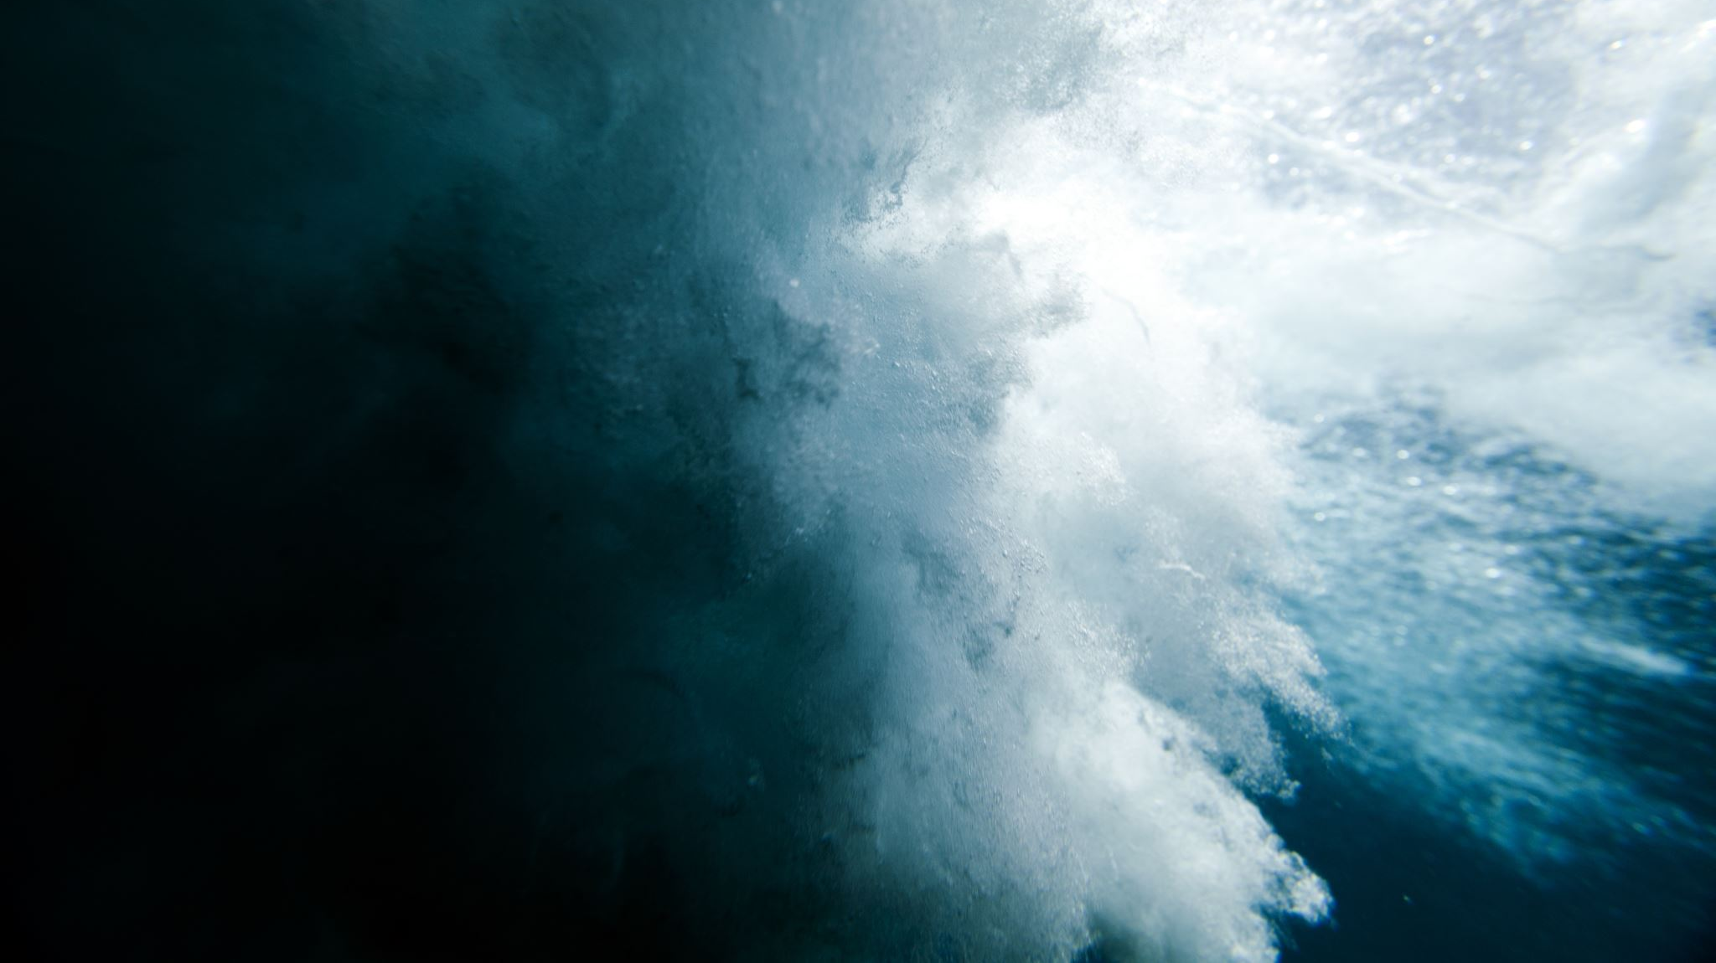
My Forgiveness Can I try…??

Slide 37
Can I try… Regular Prayer and Meditation?
To seek forgiveness for my sins and for the sins of others?
To Self-Reflect- and seek to better know myself and my Life Purpose?
To seek help and strength in my journey to becoming more forgiving?
To improve my Relationship with my Creator/Source of My Forgiveness?
To help me become a vessel of Forgiveness?

Slide 38
Can I try… Regular acts of Charity?
To help me work more easily and joyously on my kindness/ my peace/ my compassion/my empathy/my love/my gratitude/my respect/my humility/my courage/my faith/my honesty/integrity, my gratitude in order to help my Forgiveness?
1
To help me feel more able and worthy of giving and receiving forgiveness?
2
To help purify the stains on my soul from the sins that I know were not done out of ignorance- and those that I have not sincerely repented from?
3
To help me feel more worthy of having a direct connection and relationship with my Creator/Source of my Kindness/Source of my Forgiveness?
4
To help me have more Faith in The All-Forgiving Nature of The Source of My Forgiveness in order that I can seek and mend my ways with a more sincere repentance?
5

Slide 39
Can I try…
Working on my Forgiveness out of my unconditional Love for YOU so that I can have a Relationship with YOU?
Treating others how I would want to be treated?
Judging myself before Judging others?
Loving God and others with my heart mind and strength?

